Slide 1
Constructing Equity Portfolio
Team Members Group No: 61 Panel Number:2
S.No | Reg.No | Name of the Student | Section
1 | CB.EN.U4CSE18125 | Karthik Desai | CSE B
2 | CB.EN.U4CSE18160 | V.S.V.Akanksh | CSE B
3 | CB.EN.U4CSE18235 | Kushagra Kumar Agrawal | CSE C
4 | CB.EN.U4CSE18244 | Reddybathuni Mohan | CSE C
Project Advisors:
Dr. (Col.) Kumar P. N. / Professor / CSE
Dr. A. Senthil Kumar /Assistant Professor (SG)-Finance /ASB

Slide 2
Guide Approval Mail

Slide 3
Problem Definition
Constructing equity portfolios using the prominent optimization algorithms

Slide 4
Review 2 comments and responses

Slide 5
Literature Survey
1. Jithin Eapen,Abhishek Verma,Doina Bein.”Novel Deep Learning Model with CNN and
Bi-Directional LSTM for Improved Stock Market Index Prediction”. IEEE (Institute of Electrical
and Electronics Engineers) Xplore 2019.
Inference:
i. CNN layers when combined with Bidirectional LSTM show improved prediction performance
from the temporal sequence as compared to the traditional SVM regressor.
ii. Multiple pipelines of deep layers that concatenate the best of the results from three individual
pipelines performs better than single pipeline model.
b. Research gap:
i. Future research would apply deep learning toward combining model for predicting price
and trends with sentiment analysis on new data to get even better stock price index
prediction.

Slide 6
Literature Survey
2. Anita Yadav, C K Jha , Aditi Sharan.”Optimizing LSTM for time series prediction in Indian stock
market”. International Conference on Computational Intelligence and Data Science (ICCIDS 2019).
Inference:
I. The performance of LSTM is highly dependent on choice of hyper parameters.
ii. Data is fed to LSTM in batches
iii. An important hyper parameter in configuring LSTM is the number of neural layers.
Research gap:
i. The present work is limited to tuning the basic LSTM architecture. Different types of LSTM models
can be similarly tuned.
3. Akhter Mohiuddin Rather, Arun Agarwal, V.N.Sastry. “Recurrent neural network and a hybrid model for
prediction of stock return”. Expert Systems with Application, Vol 42, Issue 6, 15 April 2015..
Inference:
a. Hybrid of 2 models: linear(autoregressive moving average mode) and Nonlinear(RNN).
b. The proposed hybrid prediction model merges predictions obtained from these two prediction
based models.
Research gap :
a. Can be further enhanced by testing it in different areas such as engineering sciences, exchange
rate risk etc
b. To minimize computation time of RNN.

Slide 7
Literature Survey
4. Saud Almahdi, Steve Y. Yang, “A constrained portfolio trading system using particle swarm algorithm
and recurrent reinforcement learning”, Expert Systems with Applications, Volume 130, 2019.
a. Inference:
PSO was applied on stock market dataset with constraints as sharpe ratio, sortino ratio, calmer ratio
and a comparative analysis was made. It was concluded that PSO with Calmer ratio fits the best.
b. Research gap:
Effect of deep learning methods such as the deep recurrent reinforcement learning on the constrained
portfolio optimization where an improved recurrent network may help better capture price movement
Patterns.
5. Shile Chen And Changjun Zhou . “Stock Prediction Based on Genetic Algorithm Feature Selection and Long Short-Term Memory Neural Network ”.College of Mathematics and Computer Science , December 2020.
a. Inference:
The combination of Genetic Algorithm and LSTM. There are three Research methodologies : i) Genetic
Algorithm , ii) LSTM , iii) GA-LSTM TWO-STAGE STOCK PRICE PREDICTION MODEL
b. Research gap:
Trial and error is usually adopted instead of systematic method.

Slide 8
Literature Survey
6. Adil Moghar,Mhamed Hamiche,”Stock Market Prediction Using LSTM Recurrent Neural Network”,(IWSMAI
2020)
a. Inference:
The main objective of this paper is to see in which precision a Machine learning algorithm can predict and
how much the epochs can improve our model. The paper aims to use an ML algorithm based on LSTM
RNN to forecast the adjusted closing prices for a portfolio of assets, the main objective here is to obtain
the most accurate trained algorithm, to predict future values for our portfolio.
b. Research Gap:
The model was being trained with variable epochs. The data being considered as univariate however
no research with multivariate data combinations with epochs.

Slide 9
Literature Survey
7. Arushi Gupta,Smriti Srivastava,“Comparative Analysis of Ant Colony and Particle Swarm
Optimization Algorithms for Distance Optimization”,(ICITETM 2020)
a. Inference:
Objective is to solve two distance optimization using two separate swarm intelligence
algorithms-particle swarm and ant colony. Both the algorithms analysis is compared.Any
optimization algorithm is said to be effective if it converges to global minima in less number
of iterations.Objective is to find shortest path or distance between two vertices. Comparative
analysis is done using PSO and ACO. ACO is a probability based method on the behaviour
of ants to find the shortest path set by other ants.
b. Research Gap :
Application of ACO and PSO in stock market optimization.
c. Conclusion:
Results for both ACO and PSO were both demonstrated.It is observed that the ACO
algorithm has a lower square of error (0.2 at 80 iterations) and an overall better
performance.

Slide 10
Literature Survey
8. Jui-ChungHung,“Adaptive Fuzzy-GARCH model applied to forecasting the volatility of stock
markets using Particle Swarm Optimisation”, (2020)
a. Inference:
Objective is to forecast the stock market data for Taiwan, Germany and Japan using an
adaptive Fuzzy-Garch model and optimize it using Particle Swarm Optimization.
b. Research gap:
The fuzzy-garch algorithm can be applied in Indian stock market and appended with an
ACO/PSO optimization.
c. Conclusion:
This method brings best results for market with high-frequency, time-varying volatility. It
offers significant improvements in forecasting ability. The PSO searches for peaks within
the parameter space, so its not necessary to specify any initial conditions to improve the
result.

Slide 11
Literature Survey
9. Carlos Betancourt, Wen-Hui Chen,”Deep reinforcement learning for portfolio management of
markets with a dynamic number of assets”, Expert Systems with Applications, Volume
164,2021.
a. Inference:
In the dynamic scenario they tried to implement the portfolio management. There is a time
session in which the trading happens after that the market is evaluated and compared with
last time session. This way the market trend of cryptocurrency is analyzed and
reinforcement learning takes place.
b. Research gap:
The concept can be applied to stock market.

Slide 12
Literature Survey
10. Senthilkumar, A., Namboothiri, A., & Rajeev, S. (2021). Does portfolio optimization favor sector
or broad market investments? Journal of Public Affairs, e02752.
a. Inference:
Optimizing the portfolio there are variety of combinations, a portfolio can be of intra-sector
assets or inter sector portfolio, in intra-sector portfolio and inter-sector portfolio are compared.
A comparison is made with between the Markowitz model and Sharpe’s model.
b. Research gap:
Explore how weights change under different economic conditions .Use of advance Machine
learning algorithm.To expand it in global context

Slide 13
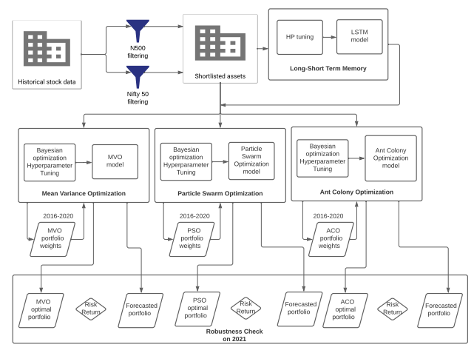
Architecture diagram

Slide 14
Detailed design diagrams Chose the most suitable graphical representation for your system. Please make sure that the diagram has proper labels, text and is easy to view and read by the panel.

Slide 15
Implementation Provide a description on the modules of the system. Details of implementation such as Algorithm, pseudocode for important modules may be included. Also, any software/hardware library dependence etc may be highlighted. This can extend 2-3 slides.

Slide 16
Results and Inferences

Slide 17
Conclusion
Here you can conclude the work, mention the possibilities for enhancement in future.

Slide 18
Publication details
Here you can give the publications details, based on the project work.

Slide 19
References(In IEEE format) Sample Z. Pi and F. Khan, “An introduction to millimeter-wave mobile broadband systems,” IEEE Communications Magazine., Vol. 49, No. 6, pp. 101–107, 2011.

Slide 20
THANK YOU

